Slide 1
Six Months INDUSTRIAL TRAINING at EXCELLENCE TECHNOLOGY
Submitted by:
Sahil(1809424)
Nikhil Dhiman(1908578)

Slide 2

ABOUT THE COMPANY
EXCELLENCE TECHNOLOGY
Excellence Technology is one of the top reputed ISO 9001:2015 Certified Software Development Company in Chandigarh, Mohali and Panchkula .
We develop a mobile application, Games, antivirus and websites. We provide Best Php, Java, Web Designing and Android training on live projects of our off shore clients.

Slide 3
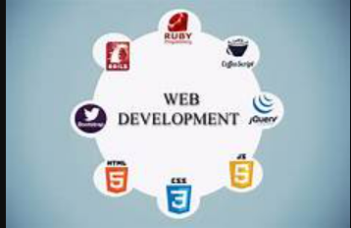

TRAINING CONSISTS OF TWO PARTS:
WEB DEVELOPMENT
PYTHON

Slide 4
WEB DEVELOPMENT
Web development refers to the building, creating, and maintaining of websites. It includes aspects such as web design, web publishing, web programming, and database management. It is the creation of an application that works over the internet i.e. websites.
The word Web Development is made up of two words, that is:
Web: It refers to websites, web pages or anything that works over the internet.
Development: Building the application from scratch.

Slide 5
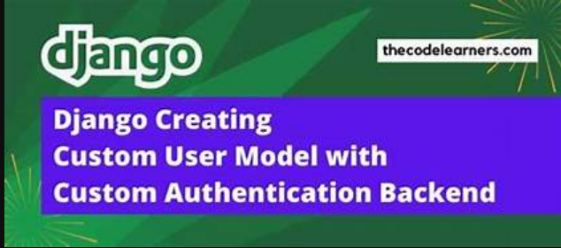

MAIN PARTS OF WEB DEVELOPMENT
DJANGO
FLASK

Slide 6
DJANGO
Django is a Web Application Framework which is used to develop web applications.
Django is a web application framework written in Python programming language. It is based on MVT (Model View Template) design pattern. The Django is very demanding due to its rapid development feature. It takes less time to build application after collecting client requirement.

Slide 7
FLASK
Flask is a web application framework written in Python. Flask is based on Werkzeug WSGI toolkit and Jinja2 template engine.
Flask is a small and lightweight Python web framework that provides useful tools and features that make creating web applications in Python easier. It gives developers flexibility and is a more accessible framework for new developers since you can build a web application quickly using only a single Python file

Slide 8
PYTHON
Python is a high-level, general-purpose and a very popular programming language. Python programming language (latest Python 3) is being used in web development, Machine Learning applications, along with all cutting edge technology in Software Industry. Python Programming Language is very well suited for Beginners, also for experienced programmers with other programming languages like C++ and Java.
Python is currently the most widely used multi-purpose, high-level programming language.
Python allows programming in Object-Oriented and Procedural paradigms.
Python programs generally are smaller than other programming languages like Java. Programmers have to type relatively less and indentation requirement of the language, makes them readable all the time.
Python language is being used by almost all tech-giant companies like – Google, Amazon, Facebook, Instagram, Dropbox, Uber… etc.

Slide 9
ADVATAGES OF PYTHON
Easy to Use — Python is compact, programmer-friendly and very easy to use object oriented language with very simple syntax rules.
Expressive Language — Python is an expressive language, it takes fewer lines of codes to represent the same syntax.
Interpreted Language — Python is an interpreted language, not a compiled language. It makes Python an easy-to-debug language and thus suitable for beginners to advanced users.
Completeness — Python has a rich standard library that provides modules for most types of required functionality like emails, web-pages, databases, GUI development, network connections, etc.
Cross-platform Language — Python can run equally well on variety of platforms — Windows, Linux/UNIX, Macintosh, supercomputers, smart phones, etc.
Free and Open Source — Python language is freely available along with its source-code.

Slide 10
About project “student study portal”
Student study portal is a portal with following features in its dashboard to make students life easy and more manageable.
1.In this project users can create text notes and refer them later, they are stored permanently until deleted.
2.users can add Homework's and assign them deadlines, they will be displayed prioritized by deadlines.
3.users can perform YouTube search and select desired videos to play it on YouTube.
4.users can add to do list for their day and remove them as the work is finished.
5.users can browse books from a list of neatly organized book menu.
6.users can enter a word and the meaning will be displayed along with its phonetic description insanutiously.
7.users can search Wikipedia to get fast results.
8.a virtual wallet is implemented to help the users to manage their expenses and keep track of it.
9.this will display all the pending to do’s and Homework to the users

Slide 11
BASIC REQUIREMENTS OF THE PROJECT
1. Python: Python is a high-level, general-purpose programming language. Its design philosophy emphasizes code readability with the use of significant indentation. Its language constructs and object oriented approach aim to help programmers write clear, logical code for small- and large-scale projects.
2.Django: Django is a Python-based web framework that allows you to quickly create efficient web applications. It is also called batteries included framework because Django provides built-in features for everything including Django Admin Interface, default database – SQLlite3, etc. When you’re building a website, you always need a similar set of components: a way to handle user authentication (signing up, signing in, signing out), a management panel for your website, forms, a way to upload files, etc. Django gives you ready-made components to use and that too for rapid development.
3.Bootstrap: Bootstrap is the popular HTML, CSS and JavaScript framework for developing a responsive and mobile friendly website.
4.Javascript: JavaScript is a lightweight, cross-platform, and interpreted scripting language. It is well known for the development of web pages many non-browser environments also use it. JavaScript can be used for Client-side developments as well as Server-side developments.

Slide 12
HARDWARE REQUIREMENTS
• Processor 1.2GHz 32-bit (Minimum)
• RAM 2GB (Minimum)
• Internet Access

Slide 13
SOFTWARE REQUIREMENTS
• Django
• Django-crispy-forms
• Wikipedia
• Dictionary API
• Google e-books API

Slide 14
APPLICATIONS
The project aimed to provide an online gateway, a Student Portal. To provide an online access that supported the application of the students. It had an effective way of providing information or notification anytime and anywhere about the rapid changes on student schedule

Slide 15
ADVANTAGES
It also benefits the environment by using fewer resources. An online portal makes it easier for students to access important information from anywhere at any time of day. A student portal is an online gateway where students can log into a school website to access important program information

Slide 16
THANK YOU

